Slide 1
PROJECT BASED PRODUCT DEVELOPMENT, 15 ECTS
Courses according to the SIMS concept - Student Innovation Mid Sweden University
Interdisciplinary projects in close cooperation with worklife

Slide 2
SIMS - Student Innovation Mid Sweden
During the first 10 weeks of the fall semester, you have the opportunity to attend an innovation course in the regional industry. You should suggest a new product or a service as solution to a problem defined by a company. Surprize the company and teachers with novel approaches!
Multi-disciplinary groups of 4 to 6 students work together using project methods and development tools for teams. Some students develop and evaluate demonstrators or prototypes as proof-of-concept. Others make business and market plans, mathematical calculcations, are project leaders, are test leaders, etc. results are essential. This is a result oriented course focusing on professional skills rather than theoretical knowledge.
Open innovation: Companies give a basic product idea or problem to the students. After the project is completed, the company may potentially buy a license to the project results from the students, but the students often still owns the intellectual property and can offer it to others. You should try to sign a contract on intellectual properties wth the company. Try to make a generic product, useful for other companies as well. Be visionary – in the final conclusions, suggest future development of your product 5-10 years from now.
Agile projects: Students choose and follow modern iterative methods and tootls for project management, and for product design and system development, implying that mock-ups, prototypes and alfa versions are delivered early in the project for testing and evaluation. Make your group happy with your contribution.
Innovation and communication coaching: You learn methods for innovation process, and practice on making comprehensible ”elevator pitches” and marketing materials, showing ability to communicate your ideas convinsingly to investors, to the company and to people with other professions.

Slide 3
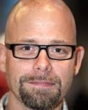
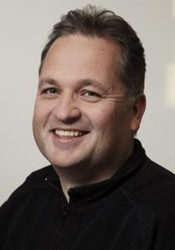
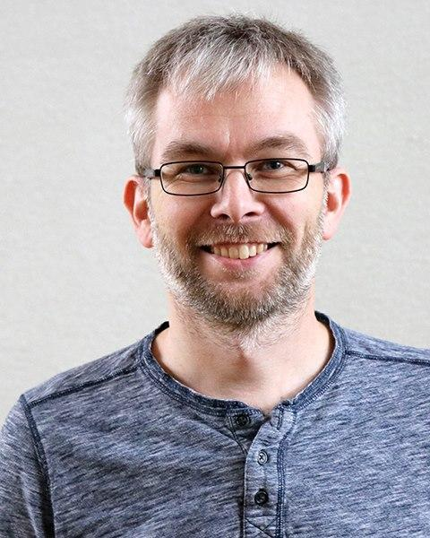
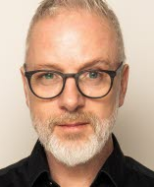
STAFF
Henrik Florén Docent, industriell ekonomi. lärare i projektlednings- och systemutvecklingsmetoder henrik.floren@miun.se
Magnus Eriksson Adjunkt, programansvarig civiling datateknik Magnus.Eriksson@miun.se
Rickard Hamrin Forskn.ing elektroniksystem sebastian.bader@miun.se
Roger Olsson Forskare i datateknik
Roger.olsson@miun.se

Slide 4
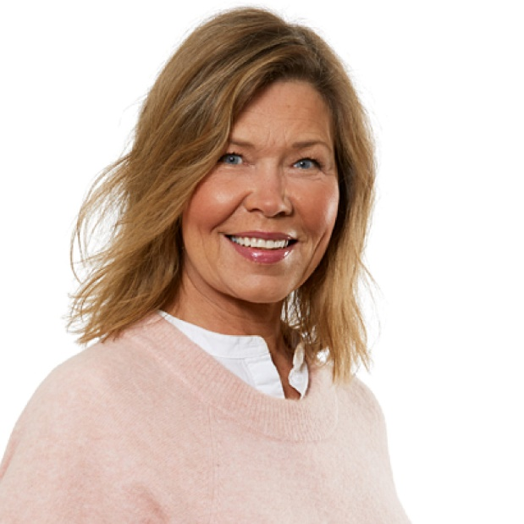
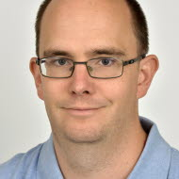
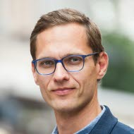
STAFF
Maria Wiik Innovationsrådgivare Bizmaker Maria.Wiik@bizmaker.se
Johan Landström Innovationsrådgivare Samverkansavdelningen Johan.landstrom@miun.se
Holger Noack Innovationsrådgivare Samverkansavdelningen Johan.landstrom@miun.se
Notes:
FÖRETAGEN FÅR PRESENTERA SIG?

Slide 5
Plan for Week 35 (first week)
Intro Lecture Wednesday
Course organization
Group division
Problem and requirements management (Maria)
IP contract, intellectual property law (Magnus)
Visit some of the group rooms
Supervision with subject teacher at Thursday/Friday
What is required to pass the course
Tools for large development teams

Slide 6
Student Background
Exchange students:
5 MSc students in computer science and engineering (DT053A)
1 BSC student in computer science and engineering (DT169G)
3 BSC students in Business management and organization (IG044G)
Swedish-speaking students:
23 BSc students in Computer engineering, 3rd year (DT169G)
6 MSE students in Computer engineering, 5th year (DT053A)
10 MSE on the Industrial engineering and management program (the in Business management and organization subject), 5th year (IG019A)
6 MSE Electrical engineering, 4th year
Totally 54 students

Slide 7
This year’s projects
01 Knowit
02 Bolagsverket
03 Technichus i MittSverige AB
04 Höga Kusten Teknikresurs AB
05 Atea
06 SPV
07 DIGG
08 Knightec
09 MIUN
See group division: https://docs.google.com/spreadsheets/d/1JdCw5HmcaXUlvECBWJn01N_KODVVGjbe3NA4DIxgrPo/edit?usp=sharing

Slide 8
Rooms (Preliminary)
01 Knowit | L522
02 Bolagsverket | L522
03 Technichus i MittSverige AB | Tvätteriet Maker Space
04 Höga Kusten Teknikresurs AB | Tvätteriet Maker Space
05 Atea | L522
06 SPV | Miun Innovation, Grönborg
07 DIGG | L207/L209 (Linux labs)*
08 Knightec | L207/L209 (Linux labs)*
09 MIUN | S241 (Master room electronics)
*) When room not schedule **) You need key. Wait until verified by Magnus.
Perhaps some of the companies will offer a room

Slide 9
Learning outcomes
See your curricula for each of the different courses. In Swedish:
Den studerande skall efter kursen kunna:
- utföra kravfångst;
- föreslå och utveckla produkter eller tjänster utifrån användares behov och förutsättningar;
- utforma produkter med hänsyn till relevanta samhälleliga och etiska aspekter;
- planera och driva projekt enligt en agil projektstyrningsmodell;
- Datateknik: välja och följa adekvat metod för testdriven och agil systemutveckling;
- Ind.ek: förmåga att föreslå produkter och utveckla tjänster utifrån ett affärsmässigt fokus
samverka med personer med andra kompetensprofiler;
- tillämpa kunskaper från tidigare kurser i ämnet, bland annat på avancerad nivå, på ett arbetslivsnära problem;
- kommunicera sin produktidé muntligen och skriftligen.

Slide 10
Student roles
The group may e.g. assign the following responsibilites to different students:
Project leadership (you may alternate)
Test leadership
Business plan
Marketing
Hardware design
Back-end programming
Front-end programming
Mathematical modelling
Modularize the design process. Maximum two students should be responsible for each software or hardware module during each ”sprint”.
Document modularization and responsibilities, for example by indicating responsibilites with colours in UML charts, and in a ”contributions” section in the final report.

Slide 11
Exampels of subject-specific requirements
Show that you have applied and extended knowledge from previous courses, and used tools for teams. This may typically mean:
In computer engineering
Use a version control system (Github, Bitbucket etc) – invite your supervisor to the project
Make component diagram and other UML diagrams
Make a few pages of working program code (HTML does not count) as part of a prototype and evaluate the result
Learn a new API, framework, language or other development tool
Advanced level students: Apply knowledge from advanced level course
In industrial engineering and management
Make a business plan that should be presented to the investors
Use a known method for requirement management

Slide 12
Course organization
See course timetable for details. If information is contradictory, we follow the timetable.
Project duration: September until first week of November (overlapping with first week of next study period).
You need an own laptop, or borrow one in Service center.

Slide 13
Mandatory attendance
Teams work every day together in a group room, 40 hours/week, as it if was a full-time employment.
Other parallell studies and jobs of more than 25% of full-time are not realistic.
At least 80% attendance is required at at least 80% of the group meetings and presentations. The project leader keeps track.
If you do not attend a seminar, you should make and additional assignment that is useful for the group. For example make a competitors analysis, or write a section in the project report. Make your group happy!
Inactive students may get an F or be unregistered within a few weeks, if we find it unrealistic that they can catch up. They are welcome to take the course next year instead.
During seminars that require mandatory presence according to the timetable, you should listen to all the other group presentations and present in English.

Slide 14
Project risks
What if the company does not deliver info that they promised?
What if a student is unable to deliver?
What if company requirements and teacher requirements differ?

Slide 15
Deliverables every 2nd week (see schedule)
Choose an agile (=iterative) project control and system development method, where the group delivers and demonstrates concrete results every 2nd week.
The deliverables may for example be plans, mockup, prototype, test results, documentation, plans and requirements for next deliverable, etc.
Every 2nd weeks:
Visit the company for testing the demonstrator and agreeing on requirements for next deliverable
Make oral presentaion of result and plans for the teachers.
Write an individual reflection where you describe your learning and analyze the method.
Upload slides and other documents in Moodle group forum
Presenting the first deliverable and a group project plan gives you your first ECTS course credits.

Slide 16
Oral presentations
In the end of every sprint, development results and test results are demonstrated for the teachers or one supervisor
Upload your slides before your presentation in your group forum
Practice your presentation for the innovation coaches in advance
Every group member do not have to present every time, for example for the investors, but everyone should say something in the final presentation. Everyone should make some presentations during the course.
At least one group member should take notes from feedback you get and address it at next presentation.

Slide 17
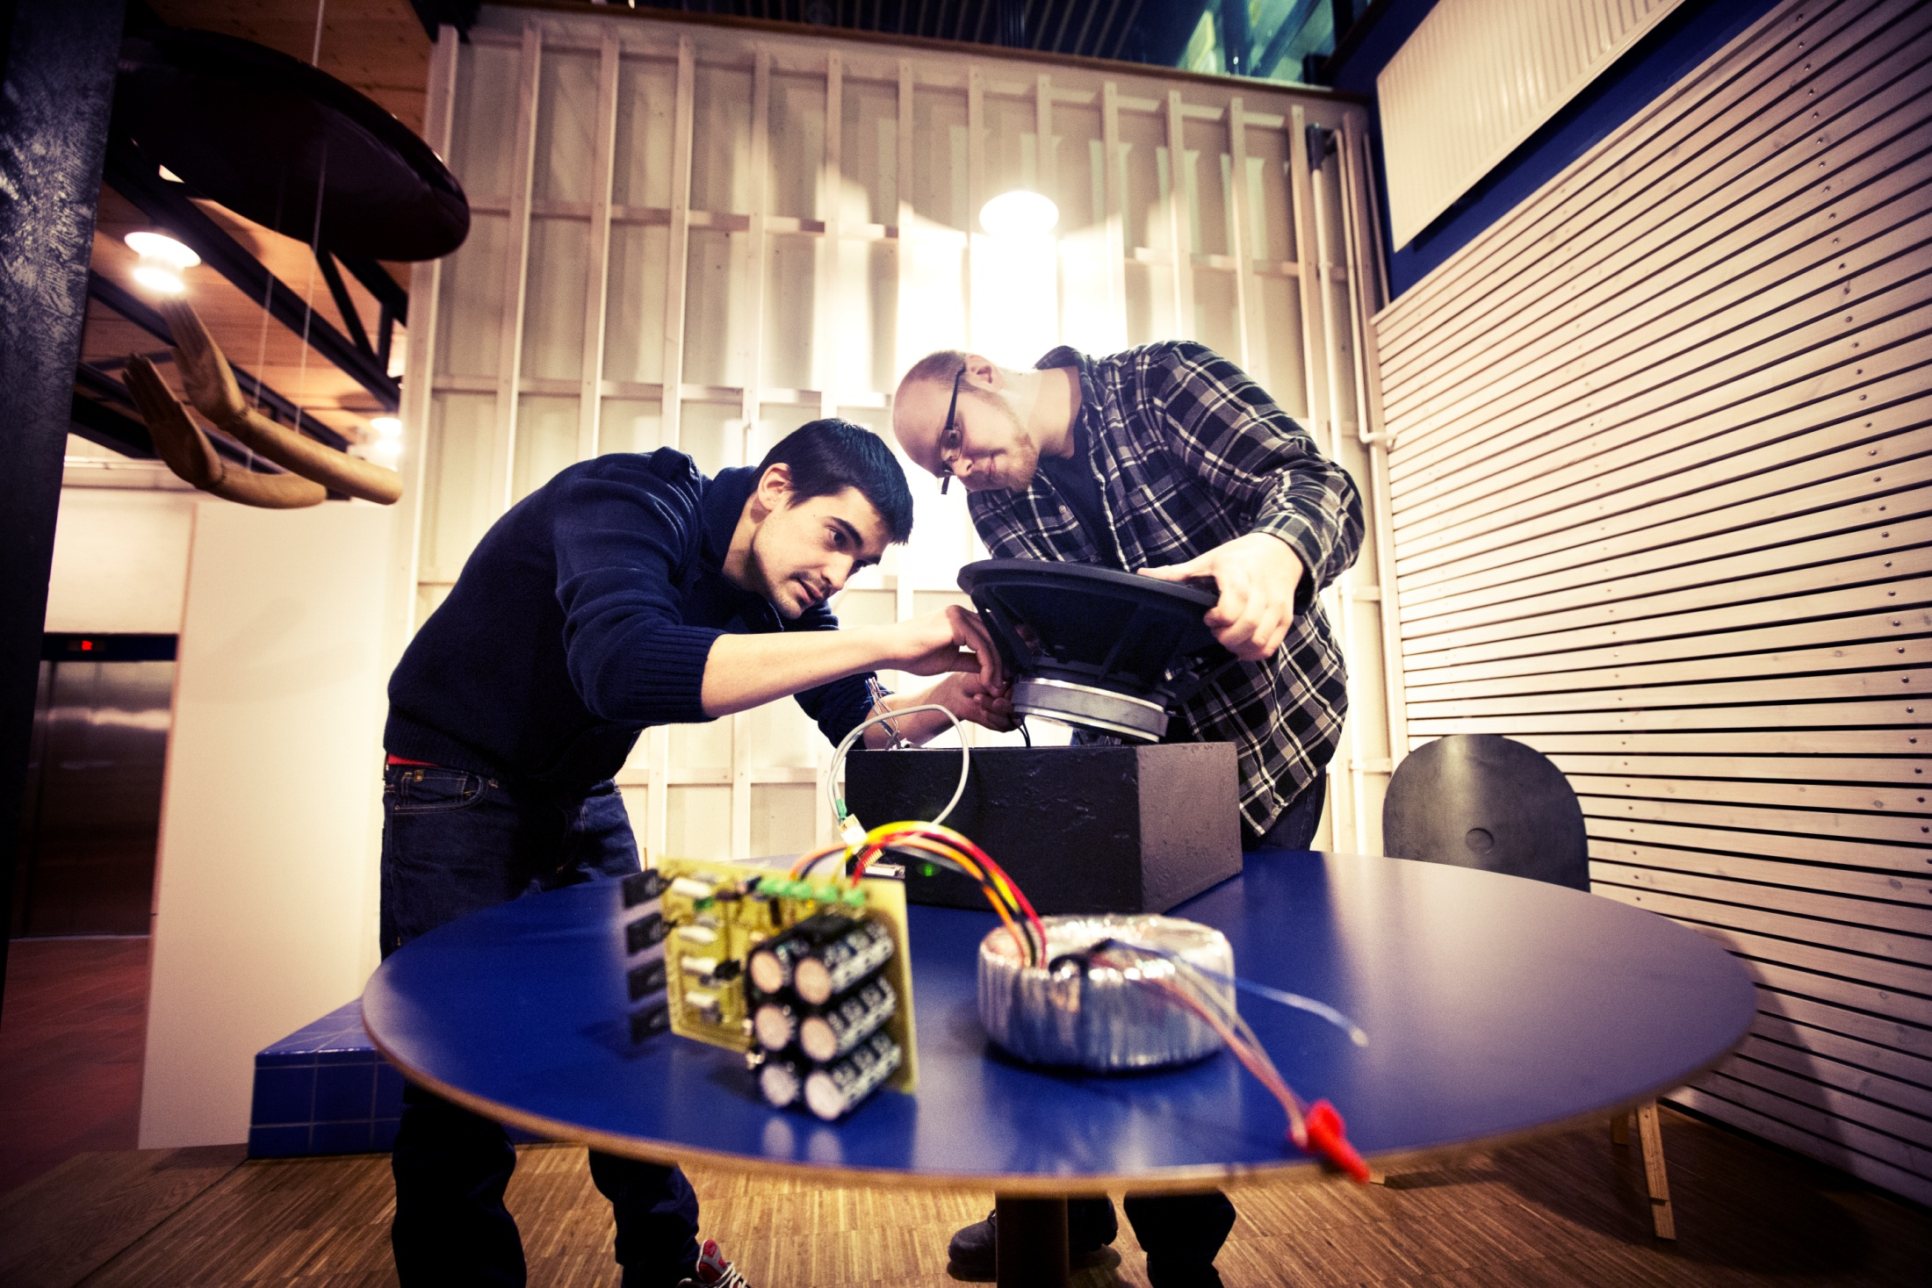
Demonstrate a prototype
Notes:
En industriell ekonomistudent var projektledare och analyserade affärsmöjligheter
Två elektronik-studenter designade prototypens hårdvara och gjorde mätningar
Två datateknik- studenter utvecklade mjukvara, protokoll och användargränssnitt

Slide 18
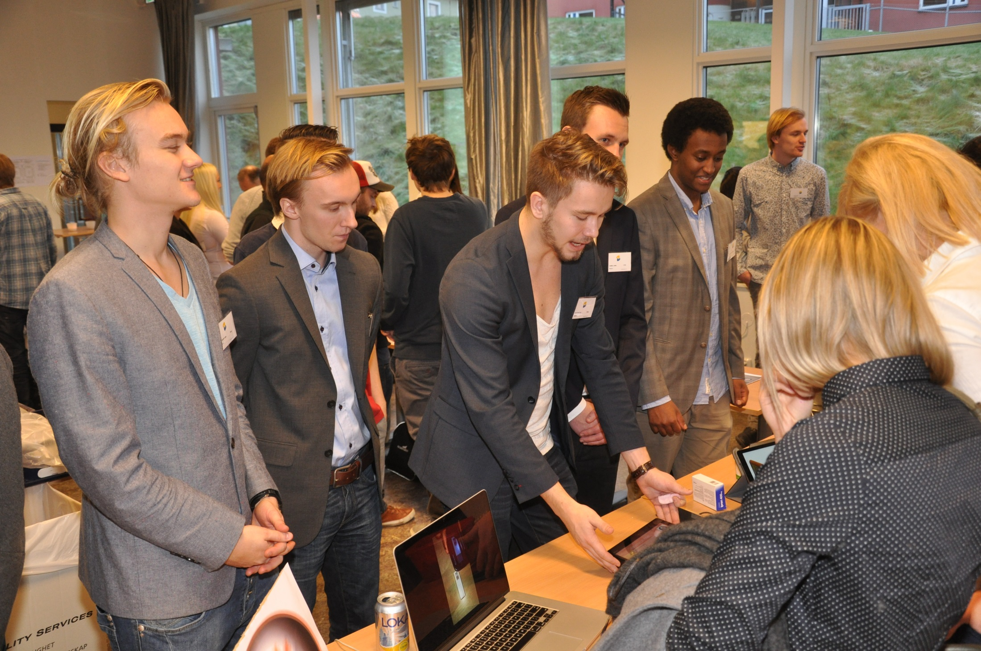
Demo exhibition
Notes:
Lisa

Slide 19
Oral presentations
Show good communication skills
Always introduce yourselves (names, study program)
Introduce presentations with a short and improved NABC ”elevator pitch” (need, approach, benefit, competitors)
Also always show illustrations, demos and results, e.g. usablity test results.
On your presentations for teachers, you may also show a more academic progress report, student roles, schematics/UML diagrams, test methods and results, analysis of method and results, motivation of design choices, backlog for next sprint, etc.
Adapt the presentation to the listener (investor, innovation coach, teacher, company)

Slide 20
Individual reflections
One week after each sprint demo, each student shall write a short individual reflection about her/his role in the team and his/her learning in relation to the course syllabus
Role: Describe your role in the group and what contributions to the result you have made or intend to make
Knowledge: Describe what new knowledge and skills you have learned during the past sprint, what knowledge from previous courses you have applied and extended, or intend to apply, and how. Give concrete examples.
Course objectives: Have you reached the course objectives/learning outcomes as stated in the syllabus? Each course objective must be discussed in at least one reflection.
Team methods: Document and analyze your use of methods and tools, and how you have cooperated with others in the team, and suggest changes for next sprint.
Attendance: Show if you have been present at all team meetings and seminars, or done some written additional assignments instead of attending the meeting

Slide 21
Company meetings
Agree with the company/organisation to meet them at least every 2nd week, a few days before Mid Sweden University presentation (see timetable), for carrying out user tests of your deliverable and agreeing on goals for next deliverable
If you travel outside the county of Medelpad, Mid Sweden University might cover travelling expenses for two trips.
Ask the company to finance other visits.
If you want to go by bus or train, check the prise and email Magnus to check if it is ok. Keep original receipts and tickets.
Standard compensation for private car has been 1.85 SEK / km for private car. Fill in a specific form. Rental car is typically not ok.

Slide 22
Grading
Only Pass and Fail.
Best group may get an award.
Demonstrating development results is central, as well as applying and extending skills from previous courses on a real world problem. Since results are related to process we are also interested in how you work as a team (= methods and tools for large groups) and that you show ability to communicate your ideas and adopt the presentions to various groups (investors, company leader, users, teachers, people in different disciplines, non-swedish speaking people, etc)

Slide 23
Project report
It should resemble a consultant project report rather than a scientific report. You should show that you use scientific methods for testing and measuring. You may cite course literature to show that you have applied previous knowledge. You typically do not need scientific sources (as in a thesis project report).
Structure your report losely based on Miun’s template for technical reports or a company template
In the report it shall be made clear who has done what
Document what method you have followed, why and how
Document your design with UML charts, block charts, etc, to make it possible for others to further develop it.
Motivate all design choices
If secret content, you may hand it in on paper.

Slide 24
Week 35 (First course week)
Wednesday: Course introduction
Thursday or Friday: Subject teachers show methods and tools.
Prepare your problem analysis.
Agree on project methods and system development methods.

Slide 25
Week 36 (Second course week)
Course introduction
Monday: First company visit
Try to sign IP agreement. (Show copy to Magnus. Avoid showing results to company before agreement is signed)
The company presents their organization and problem.
Start carrying out requirement/problem analysis.
Start identifying potential competitors

Slide 26
Week 36-37: Innovation coaching
Three day innovation exercise with Christoph and Karolina.
Preparation: Identify possible competitors and alternative solutions before this exercise.
Content:
Team work processes
Creative idea development
NABC model (Need, Approach, Benefit, Cost)
Practice pitch presentation skills
Present first NABC pitch suggestion for supervisors.

Slide 27
Week 37: Project plan
Present and provide a written project plan including the following:
Problem definition: Overall aim/company need/market need
Measurable goals (e.g. some performance measure)
Suggested prototype (block chart/component diagram)
Division of labour / roles in the group
A time schedule with activities and the time you estimate for each activity
Project methods and development tools you have chosen
Perhaps a project risk analysis
The project plan corresponds to chapter 1 (intro) and 3 (method) in the final report.
A final version should be uploaded in your forum within one week after the presentation, in agreement with the company.
For each delivery, revise (and version) the project plan
Any change must be in agreement with your company

Slide 28
Week 38: First sprint demo
Present and provide a preliminary written project plan
Show some test results, e.g. from a usability test for a mockup.

Slide 29
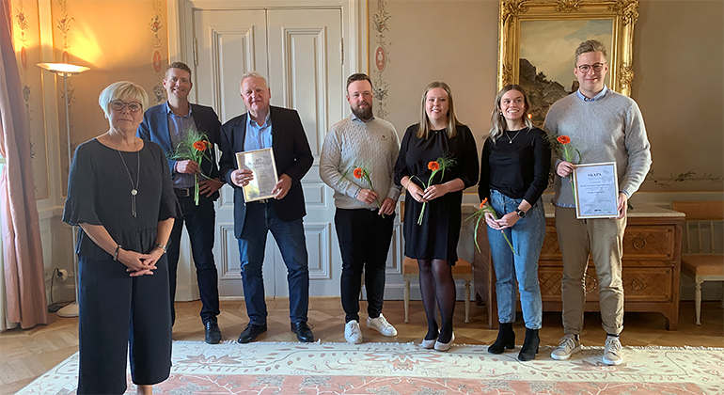
Atea project rewarded by the county 2020

Slide 30
Week 45 and 46
Final project presentations
Individual/groupwise meeting with your supervisor and examinor
Mytec Day with exhibition

Slide 31
Problem identification: The SPIN method
What impact has the problem, how costly and how urgent?
S – situation, establish current situation
P – understand the problemet, identify discontent
I – Implication, explore causes and effects of the problem, who are affected and in which way, what are the consequenses
N – need of solution, what is the value of a solution, what need would a solution bring to the organisation

Slide 32
Identify stake-holders
Who are the stake-holders of your project?

Slide 33
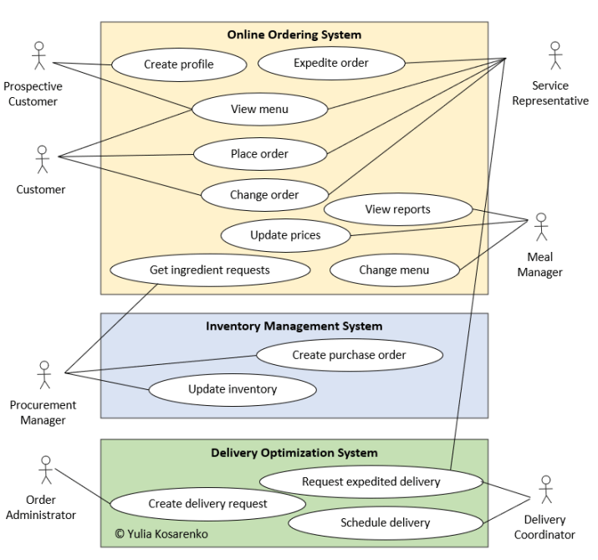
Use-case diagram

Slide 34

Intellectual property agreement (IPR)
IPR or IP agreement is often written when R&D cooperation is initiated, and sometimes at theses projects and project courses in industry
It may involve:
Non-disclosure agreement, NDA
Company requirements to review and classify part os exam reports and research articles before publication, or delayed publishing while waiting for patent application
Access to and usufruct (Sw. Nyttjanderätt) to project results
Intellectual ownership of:
Patents on ideas
Copyright on documents, source code, blueprints, etc.
Design patent (sw. mönsterskydd)
Trademarks (sw. mönsterskydd)
Licence agreement

Slide 35
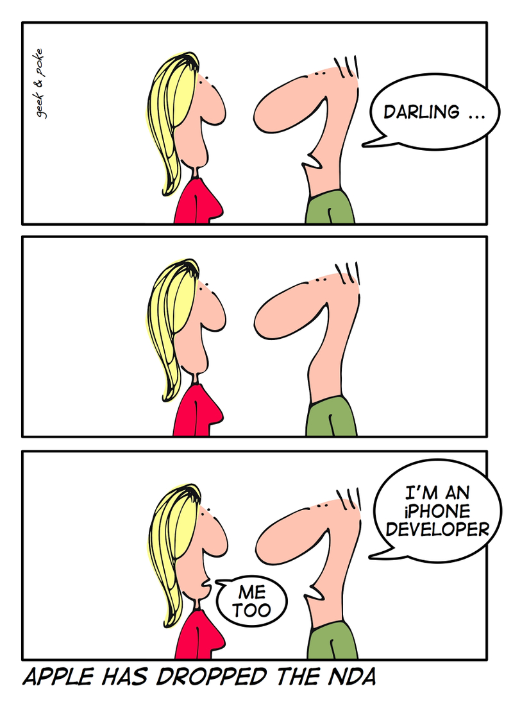

End of 2007
“The NDA has created too much of a burden on developers, authors and others interested in helping further the iPhone’s success, so we are dropping it for released software. Developers will receive a new agreement without an NDA covering released software within a week or so. Please note that unreleased software and features will remain under NDA until they are released.”

Slide 36
Three options
Prioprietary ownership to the company if they pay you – they may sell the product to competitors.
”Open innovation” – the company gives away the idea and may pay you for access to the result but not for ownership. Advantage: Other companies may put money into the project.
Open source/open content – you keep the intellectual copyright but not the economical. Advantage: You can reuse other open source libraries without paying software licenses. You may still get paid for the work, and for documentation and future support, but not for ownership. Some companies require open source solutions.

Slide 37
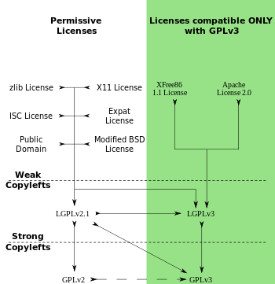
Open source licenses
Arrows show compatiblity

Slide 38
EXAMPLE OF THESES PROJECT IPR
§ 1 Parter Följande avtal gäller å ena sidan studenten (namn och personnr) vid X universitet nedan kallad Studenten, samt å andra sidan företaget (AB, org nr) nedan kallat Företaget.
§ 2 Sekretess Studenten förbinder sig att hantera sådan information som inte är offentlig eller på annat sätt är att anse som allmän eller allmänt känd, konfidentiellt, som fås i samband med projektet. Studenten har dock rätt att diskutera projektet med lärare och andra studenter ingående i samma projekt samt att redovisa projektet såväl muntligt inför lärare och studenter vid Karlstads universitet, som skriftligt. På skriftlig begäran av Företaget kan rapporten hemligstämplas i maximalt fem år. Företaget förbinder sig å sin sida att behandla information som fås från Studenten konfidentiellt. Speciellt gäller detta information som kan göra att nyhetshinder uppstår vad gäller immaterialrättsligt skydd.
§ 3 Immaterialrätt Alla av Studenten framtagna nya uppfinningar, inkluderat produkter, processer, tekniker, förbättringar eller annat, som uppstår ur arbetet och som skulle kunna vara föremål för immaterialrättsligt skydd, patentskydd eller annat immaterialrättsligt skydd, ska tillfalla Studenten. Företaget äger dock rätt att, mot utgivande av skälig ersättning till studenten, helt eller delvis förvärva rätten till eventuell uppfinning. Företagets intresse av ett eventuellt förvärv ska meddelas studenten inom tre månader efter det att uppfinningen blev känd för företaget.

Slide 39
Vid fastställande av ersättning ska hänsyn tas till graden av rättighetsförvärv samt till i vilken grad företaget bidragit till uppfinningens framtagande. Utnyttjar inte företaget denna rättighet till förvärv, äger Studenten själv rätt att söka immaterialrättsligt skydd för, samt att exploatera eventuell uppfinning.
§ 4 Ansvar Studenten ska bedriva arbetet självständigt. Studenten bär inte ansvar för projektet rent resultatmässigt, och har inte något ansvar ekonomiskt för projektet. Företaget ska avsätta rimliga resurser, vari ingår en kontaktperson, för att projektet ska kunna bedrivas enligt uppgjort tidsplan. Vid eventuella inköp till projektet, ska företaget faktureras direkt.
§ 5 Resultat och rapportering När projektet är avslutat ska Studenten till Företaget lämna en muntlig och en skriftlig rapport av projektarbetet, tillsammans med en kostnadsredovisning med originalverifikat.
§ 6 Ändringar Samtliga ändringar av och tillägg till detta avtal ska vara skriftliga och undertecknade av båda parter för att anses giltiga.
§ 7 Tvist Tvister angående detta avtals tolkning ska avgöras av allmän svensk domstol. Av detta avtal har Studenten och Företaget tagit var sitt exemplar. Undertecknas av Studenten och Företagets firmatecknare.
Källa: Karlstad universitet.

Slide 40
IPR template
 | Yes | No
The student(s) receives the Buyer’s confidential information and undertakes to respect the confidentiality in accordance with the confidentiality agreement.
 | Criterion | Sum payable
I | [Example: Conceptual idea. Captured requirements, test results and business plan. Source code and/or detailed design for prototype or demonstrator, either as immaterial right or access to open source/open content, if agreed upon in the project plan.] | 3000 SEK per contributing student.
II | [Example: Ownership of source code, detailed design and test results for nearly final commercial product.] | 6000 SEK per contributing student.
III

Slide 41
Discuss
What has your company promised in their slides in terms of ownership and possibility of compensation?
What criteria do you think that the company wants you to write in section 6 of the template - and what do you want to write?
Which option do you think your company prefers: Chance to pay for propriatary results, open innovation or open source/open content? Why? How should the template be filled in to handle that?

